Slide 1
The project setup

Slide 2
The SportsStore Application
In this example, we will be creating an e-commerce application.
The application, called SportsStore, will follow the classic approach taken by online stores everywhere.
We will create
an online product catalog that customers can browse by category and page
a shopping cart where users can add and remove products
a checkout where customers can enter their shipping details and place their orders.
we will also create an administration area that includes create, read, update, and delete (CRUD) facilities for managing the catalog—and we will protect it so that only logged-in administrators can make changes.
Finally, you will be shown how to prepare and deploy an Angular application.

Slide 3
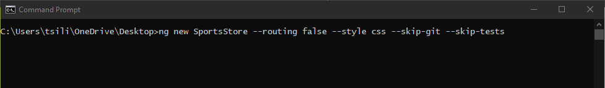
Preparing the Project
To create the SportsStore project, open a command prompt, navigate to a convenient location, and run the following command:
ng new SportsStore --routing false --style css --skip-git --skip-tests

Slide 4
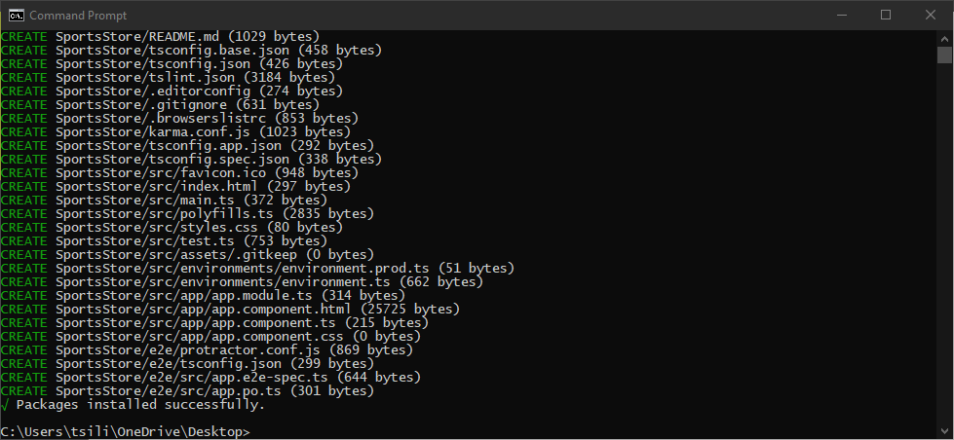
Preparing the Project (continued)
The angular-cli package will create a new project for Angular development, with configuration files, placeholder content, and development tools.
The project setup process can take some time since there are many NPM packages to download and install.

Slide 5
Installing the Additional NPM Packages
Additional packages are required for the SportsStore project, in addition to the core Angular packages and build tools set up by the ng new command.
Run the following commands to navigate to the SportsStore folder and add the required packages:
cd SportsStore
npm install bootstrap@4.4.1
npm install @fortawesome/fontawesome-free@5.12.1
npm install --save-dev json-server@0.16.0
npm install --save-dev jsonwebtoken@8.5.1
It is important to use the version numbers shown in the listing.
You may see warnings about unmet peer dependencies as you add the packages, but you can ignore them.
Some of the packages are installed using the --save-dev argument, which indicates they are used during development and will not be part of the SportsStore application.

Slide 6
Adding the CSS Style Sheets to the Application
Once the packages have been installed, add the statements shown in the following code listing to the angular.json file to incorporate the CSS files from the Bootstrap CSS framework and the Font Awesome packages into the application.
We will use the Bootstrap CSS styles for all the HTML content in the SportsStore application, and we will use icons from the Font Awesome package to present a summary of a shopping cart to the user.

Slide 7
Adding the CSS Style Sheets to the Application
...
"architect": {
"build": {
"builder": "@angular-devkit/build-angular:browser",
"options": {
"outputPath": "dist/SportsStore",
"index": "src/index.html",
"main": "src/main.ts",
"polyfills": "src/polyfills.ts",
"tsConfig": "src/tsconfig.app.json",
"assets": [
"src/favicon.ico",
"src/assets"
],
"styles": [
"src/styles.css",
"node_modules/bootstrap/dist/css/bootstrap.min.css",
"node_modules/@fortawesome/fontawesome-free/css/all.min.css"
],
"scripts": []
},

Slide 8
Preparing the RESTful Web Service
The SportsStore application will use asynchronous HTTP requests to get model data provided by a RESTful web service.
REST is an approach to designing web services that use the HTTP method or verb to specify an operation and the URL to select the data objects that the operation applies to.
We added the json-server package to the project in the previous section.
This is an excellent package for creating web services from JSON data or JavaScript code.

Slide 9
Preparing the RESTful Web Service (continued)
Add the statement shown in the following code listing to the scripts section of the package.json file so that the json-server package can be started from the command line:
...
"scripts": {
"ng": "ng",
"start": "ng serve",
"build": "ng build",
"test": "ng test",
"lint": "ng lint",
"e2e": "ng e2e",
"json": "json-server data.js -p 3500 -m authMiddleware.js"
},
...

Slide 10
Preparing the RESTful Web Service (continued)
Create a data.js file in the SportsStore Folder with the following code:
module.exports = function () {
return {
products: [
{ id: 1, name: "Kayak", category: "Watersports",
description: "A boat for one person", price: 275 },
{ id: 2, name: "Lifejacket", category: "Watersports",
description: "Protective and fashionable", price: 48.95 },
{ id: 3, name: "Soccer Ball", category: "Soccer",
description: "FIFA-approved size and weight", price: 19.50 },
{ id: 4, name: "Corner Flags", category: "Soccer",
description: "Give your playing field a professional touch",
price: 34.95 },
{ id: 5, name: "Stadium", category: "Soccer",
description: "Flat-packed 35,000-seat stadium", price: 79500 },
{ id: 6, name: "Thinking Cap", category: "Chess",
description: "Improve brain efficiency by 75%", price: 16 },
{ id: 7, name: "Unsteady Chair", category: "Chess",
description: "Secretly give your opponent a disadvantage",
price: 29.95 },
{ id: 8, name: "Human Chess Board", category: "Chess",
description: "A fun game for the family", price: 75 },
{ id: 9, name: "Bling King", category: "Chess",
description: "Gold-plated, diamond-studded King", price: 1200 }
],
orders: []
}
}

Slide 11
Preparing the RESTful Web Service (continued)
The code above defines two data collections that will be presented by the RESTful web service.
The products collection contains the products for sale to the customer, while the orders collection will contain the orders that customers have placed (but which is currently empty).
The data stored by the RESTful web service needs to be protected so that ordinary users can’t modify the products or change the status of orders.
The json-server package doesn’t include any built-in authentication features, so start with creating a file called authMiddleware.js in the SportsStore folder.

Slide 12
Preparing the RESTful Web Service (continued)
Now, add the code shown in the following code listing:
const jwt = require("jsonwebtoken");
const APP_SECRET = "myappsecret";
const USERNAME = "admin";
const PASSWORD = "secret";
const mappings =
{
get: ["/api/orders", "/orders"],
post: ["/api/products", "/products", "/api/categories", "/categories"]
}
function requiresAuth(method, url)
{
return (mappings[method.toLowerCase()] || [])
.find(p => url.startsWith(p)) !== undefined;
}

Slide 13
Preparing the RESTful Web Service (continued)
module.exports = function (req, res, next)
{
if (req.url.endsWith("/login") && req.method == "POST")
{
if (req.body && req.body.name == USERNAME && req.body.password == PASSWORD)
{
let token = jwt.sign({ data: USERNAME, expiresIn: "1h" }, APP_SECRET);
res.json({ success: true, token: token });
}
else
{
res.json({ success: false });
}
res.end();
return;
}

Slide 14
Preparing the RESTful Web Service (continued)
else if (requiresAuth(req.method, req.url))
{
let token = req.headers["authorization"] || "";
if (token.startsWith("Bearer<"))
{
token = token.substring(7, token.length - 1);
try
{
jwt.verify(token, APP_SECRET);
next();
return;
}
catch (err)
{ }
}
res.statusCode = 401;
res.end();
return;
}
next();
}

Slide 15
Preparing the RESTful Web Service (continued)
The code above inspects HTTP requests sent to the RESTful web service and implements some basic security features.
This is server-side code that is not directly related to Angular development, so don’t worry if its purpose isn’t immediately obvious.

Slide 16
Preparing the HTML File
Every Angular web application relies on an HTML file that is loaded by the browser and that loads and starts the application.
Edit the index.html file in the SportsStore/src folder to remove the placeholder content and to add the elements shown in the following code listing:
<!doctype html>
<html lang="en">
<head>
<meta charset="utf-8">
<title>SportsStore</title>
<base href="/">
<meta name="viewport" content="width=device-width, initial-scale=1">
<link rel="icon" type="image/x-icon" href="favicon.ico">
</head>
<body class="m-2">
<app>SportsStore Will Go Here</app>
</body>
</html>

Slide 17
Preparing the HTML File (continued)
The HTML document above includes an app element, which is the placeholder for the SportsStore functionality.
There is also a base element, which is required by the Angular URL routing features that we will add to the SportsStore project later.

Slide 18
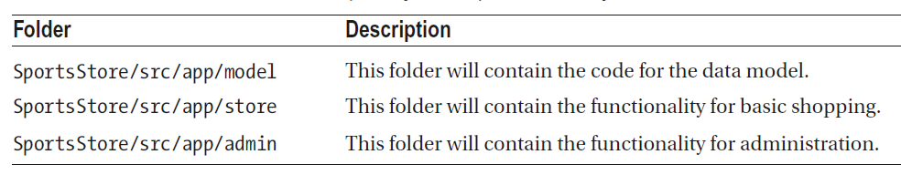
Creating the Folder Structure
An important part of setting up an Angular application is to create the folder structure.
The ng new command sets up a project that puts all of the application’s files in the src folder, with the Angular files in the src/app folder.
To add some structure to the project, create the additional folders shown in the following table:

Slide 19
Running the Example Application
Make sure that all the changes have been saved, and run the following command in the SportsStore folder:
ng serve –open
This command will start the development tools set up by the ng new command, which will automatically compile and package the code and content files in the src folder whenever a change is detected.

Slide 20
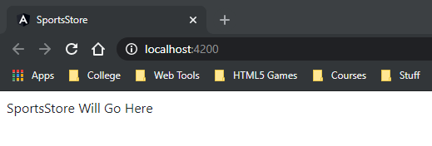
Running the Example Application (continued)
A new browser window will open:
The development web server will start on port 4200, so the URL for the application will be http://localhost:4200.
You don’t have to include the name of the HTML document because index.html is the default file that the server responds with.
You will see errors in the browser’s JavaScript console, which can be ignored for the moment.

Slide 21
Starting the RESTful Web Service
To start the RESTful web service, open a new command prompt, navigate to the SportsStore folder, and run the following command:
npm run json
The RESTful web service is configured to run on port 3500.
To test the web service request, use the browser to request the URL http://localhost:3500/products/1

Slide 22
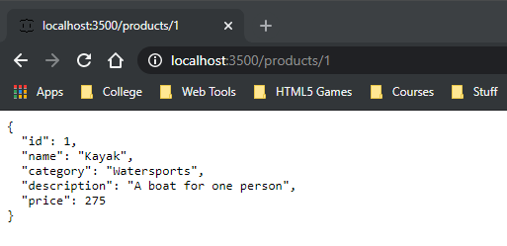
Starting the RESTful Web Service (continued)
The browser will display a JSON representation of one of the products:

